Slide 1

STATE AGENCY FOR PUBLIC SERVICE AND SOCIAL INNOVATIONS UNDER THE PRESIDENT OF THE REPUBLIC OF AZERBAIJAN
E-System for Permits and Monitoring to be applied during the Special Quarantine Regime

Slide 2
The e-GOV Development Center under the State Agency for Public Service and Social Innovations under the President of the Republic of Azerbaijan («ASAN xidmat») together with the Ministry of Internal Affairs has created a "E-System for Permits and Monitoring to be applied during the Special Quarantine Regime".
In a short period of time, the system reacted citizens' inquiries starting from April 5, 2020

Slide 3
SYSTEM PREPARATION
PERIOD
less than 1 week
DEVELOPED
100 %
TESTED
PUT INTO OPERATION
Even at the highest load, the system continues to operate without interruption and technical problems.

Slide 4
SYSTEM operates
based on 2 channel:
www.icaze.e-gov.az
System for Obtaining Permits and Monitoring during the Implementation of the Special Quarantine Regime
01
02
8108
SMS permission for citizens due to daily needs and necessary cases

Slide 5
www.icaze.e-gov.az
E-System for Permits and Monitoring to be applied during the Special Quarantine Regime
PUBLIC AND PRIVATE ORGANIZATIONS
Authorized persons enter the portal icaze.e-gov.az through the single sign-on system "ASAN Login“ through mobile signature "Asan İmza” and electronic sigature “e-Imza" available in "ASAN Login"
#01
#02
authorized persons of public and private organizations enters the portal
make an application in the portal for their necessary employees
#03
#04
the information is automatically sent to the Ministry of Internal Affairs
after reviewing, the system notifies the representative about the result

Slide 6
8103
SMS permission for citizens due to daily needs and necessary cases
CITIZENS AND FOREIGNERS OR STATELESS PERSONS
To obtain a permission to leave the home, citizens send a SMS message to 8103 from their mobile numbers indicating a special code corresponding to the one of the following and the serial number of their ID cards
#01
for urgent medical necessity and receiving treatment on any schedule.
3 CODE
#02
for food purchase and other daily necessities, as well as medicines, and to use banking and postal services.
#03
for attending the funeral of a relative
The permits are effective within time duration set up for each case as of the time (minute, hour) of the receipt of the reply SMS.

Slide 7
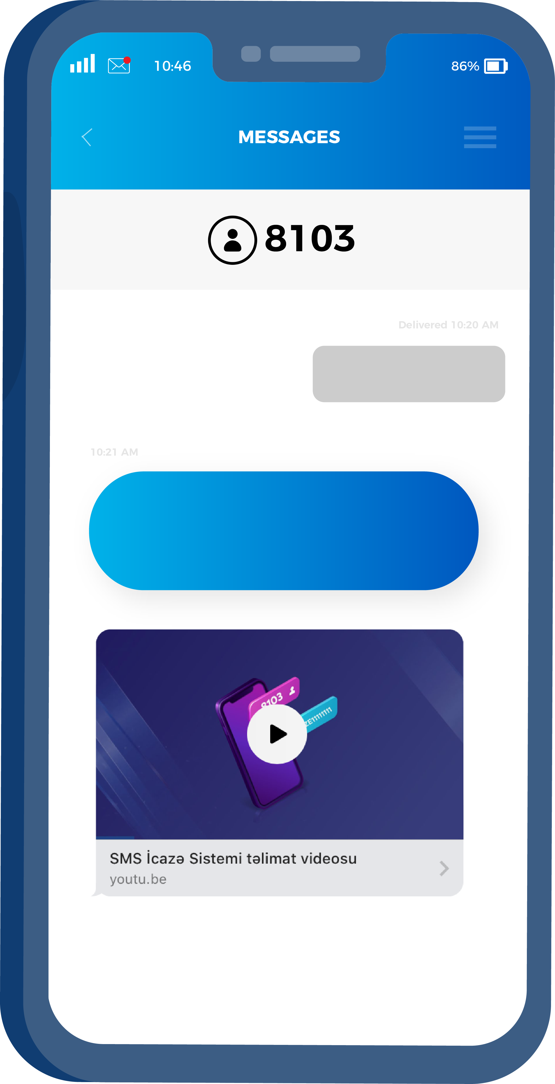
8103
SMS permission for citizens due to daily needs and necessary cases
1 AZE00000000
You receive this SMS on the 1st index and your validity for 2 hours. A medical document is required for a longer period of time
#01
for urgent medical necessity and receiving treatment on any schedule.

Slide 8
CALL CENTER
9108
Ai
special number of "ASAN service"
Ps
Citizens may call to the Call Center and ask their questions regarding the rules of applications of the SMS permits.

Slide 9
Awareness-raising about “E-System for Permits and Monitoring to be applied during the Special Quarantine Regime” and its services
Citizens are regularly informed about the services rendered and the rules applied by “E-System for Permits and Monitoring to be applied during the Special Quarantine Regime” through various digital channels.

Slide 10
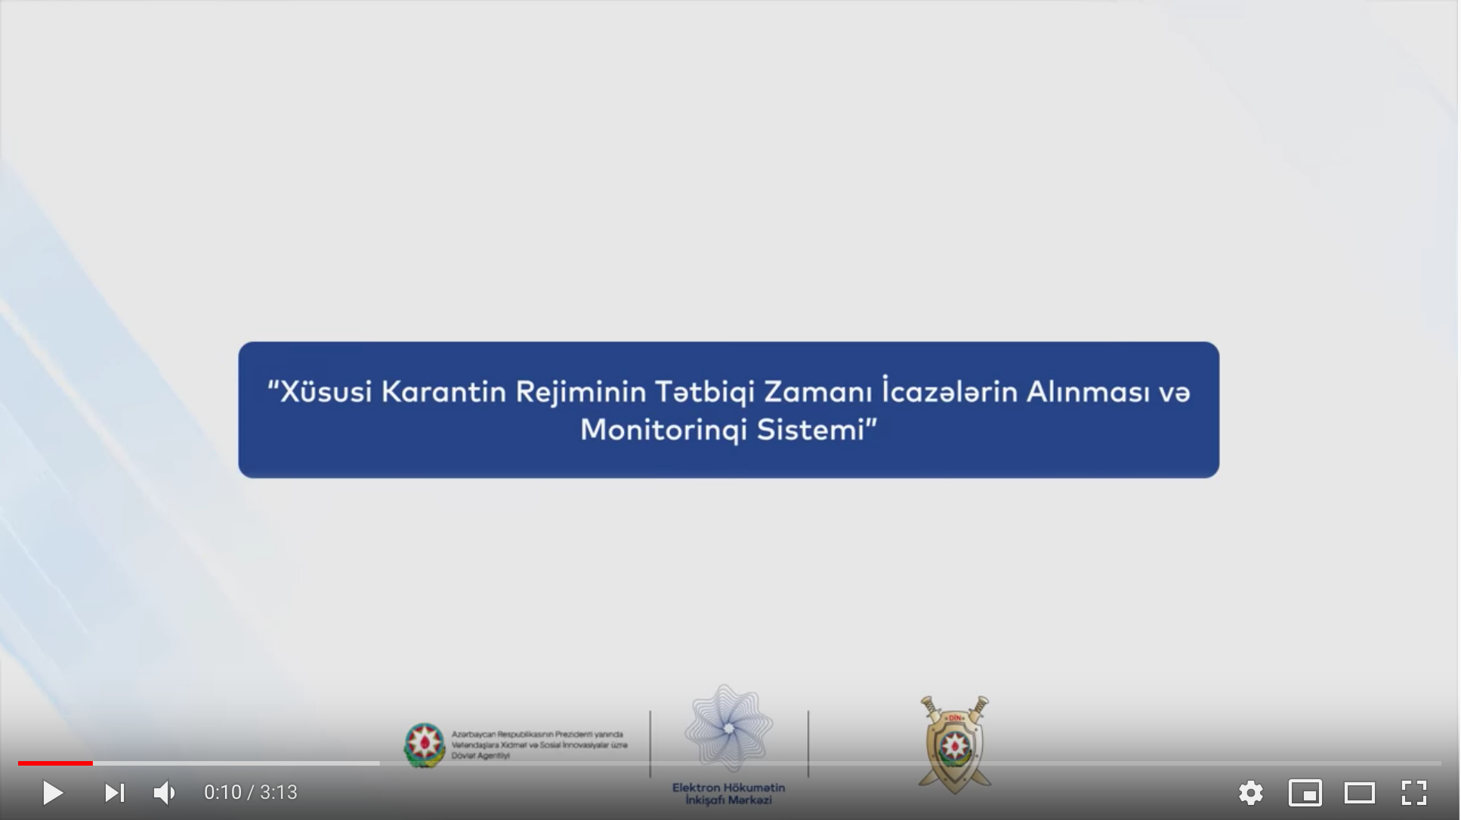

VISUAL COMMUNICATIONS
Some visual communication materials
https://www.youtube.com/watch?v=3wgXfmb9hBg

Slide 11
VISUAL COMMUNICATIONS
Some visual communication materials
https://bit.ly/39JR1e3

Slide 12
STATISTICS
www.icaze.e-gov.az
E-System for Permits and Monitoring to be applied during the
Special Quarantine Regime
NUMBER OF ORGANIZATIONS
NUMBER OF TOTAL APPLICATIONS
NUMBER OF APPROVED PERMITS
PERCENTAGE OF APPROVED PERMITS
NUMBER OF APPROVED VEHICLES
₃₄ ₉₀₉
₅₃₀ ₄₂₂
₅₂₉ ₀₁₄
_{99.7%}
₁₆₃ ₁₆₉

Slide 13
STATISTICS
8103
Permission system through SMS
NUMBER OF
TOTAL SMS
NUMBER OF APPROVED PERMITS
PERCENTAGE OF APPROVED PERMITS
NUMBER OF UNIQUE CITIZENS
AVERAGE RESPONSE TIME
₁ ₄₄₄ ₇₆₉
₆₀₈ ₂₈₁
_{42%}
₅₁₀ ₅₄₄
_{195 sec}
As of April 6, 2020, 16:00

Slide 14
STATE AGENCY FOR PUBLIC SERVICE AND SOCIAL INNOVATIONS UNDER THE PRESIDENT OF THE REPUBLIC OF AZERBAIJAN
THANK YOU FOR ATTENTION

